Slide 1



Counterfactual Explanations with Probabilistic Guarantees on their Robustness to Model Change
Ignacy Stępka ᵃ, Jerzy Stefanowski ᵃ, Mateusz Lango ᵃ ᵇ
ᵃ Poznan University of Technology, Poznan, Poland
ᵇ Charles University, Prague, Czech Republic
KDD 2025, Toronto, Canada

Slide 2
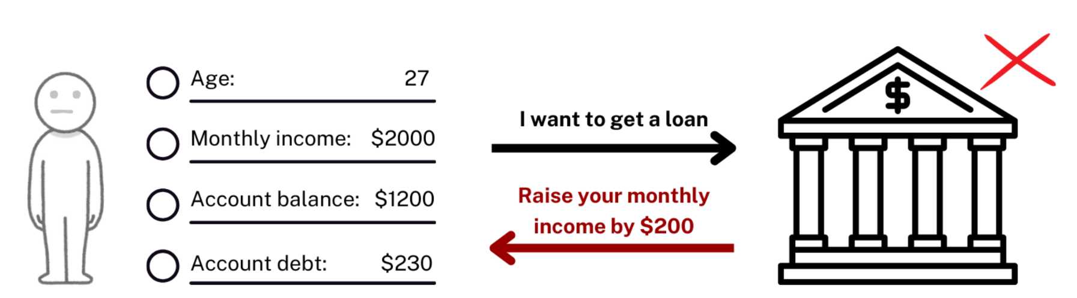
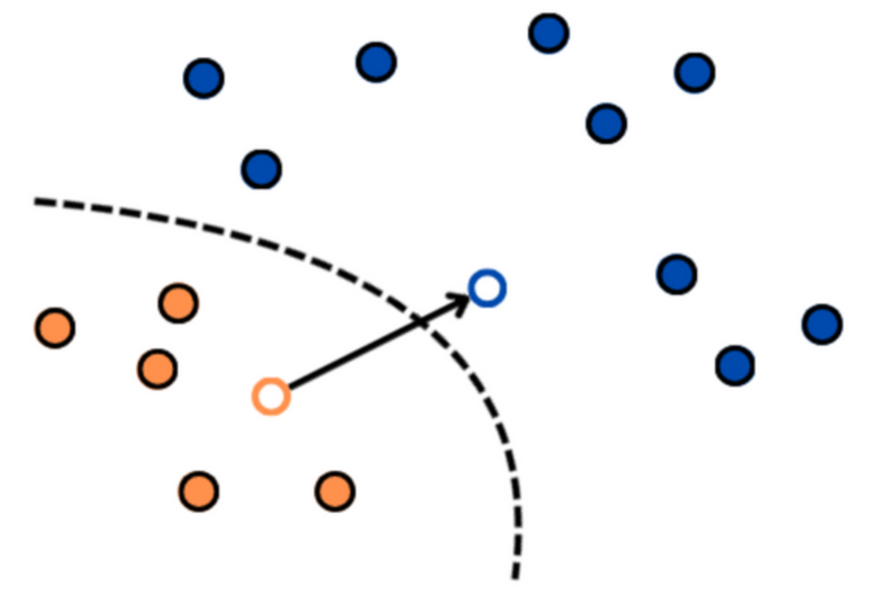
Counterfactual Explanations
Definition by Wachter et al: “The closest possible world in which the decision would have been different”
Intuitively, you can think of it as a what-if scenario: “If X had been different, you would have gotten Y instead”
Counterfactuals are minimal changes to the input that would change the output, without requiring knowledge of the internal model.

Slide 3
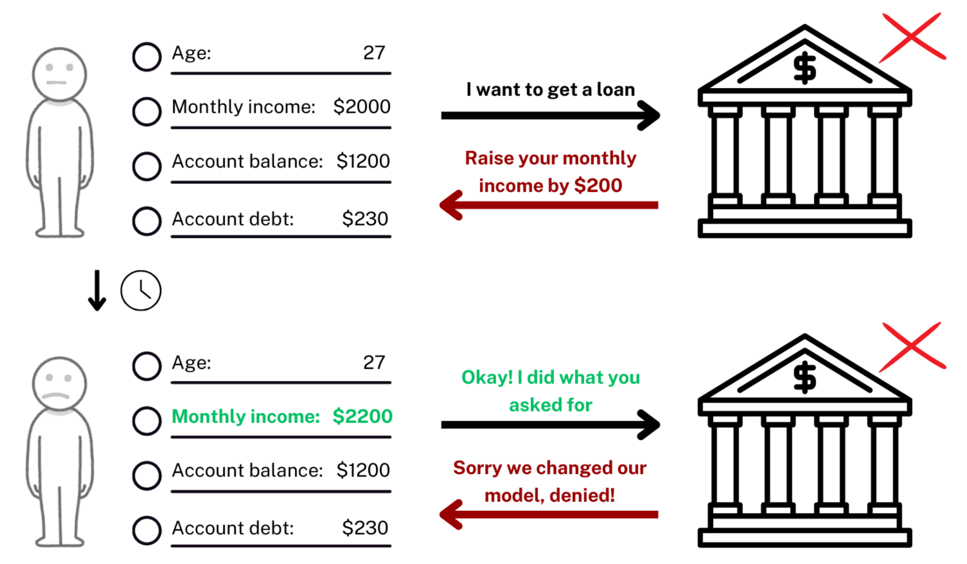
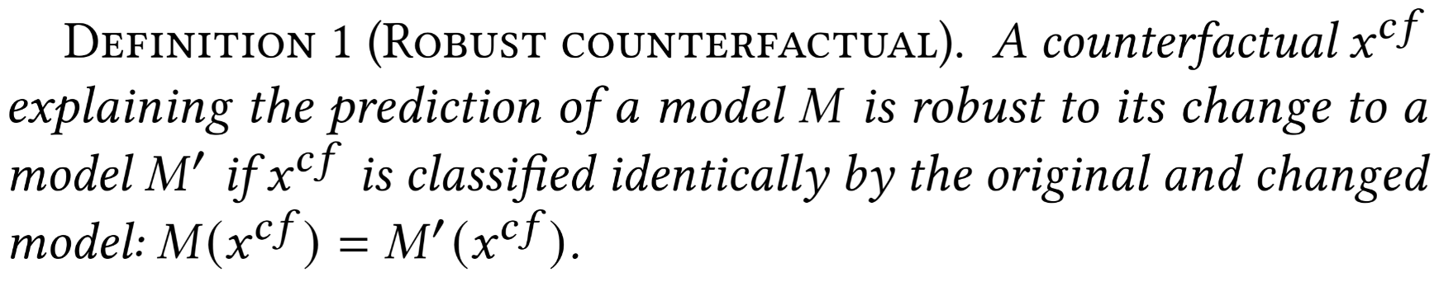
Robust Counterfactual Explanations
A counterfactual is robust if it’s classified identically for both the original model and a new, changed model.

Slide 4
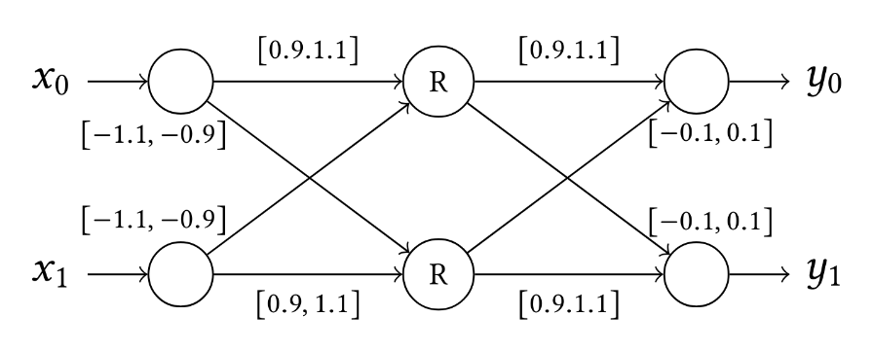
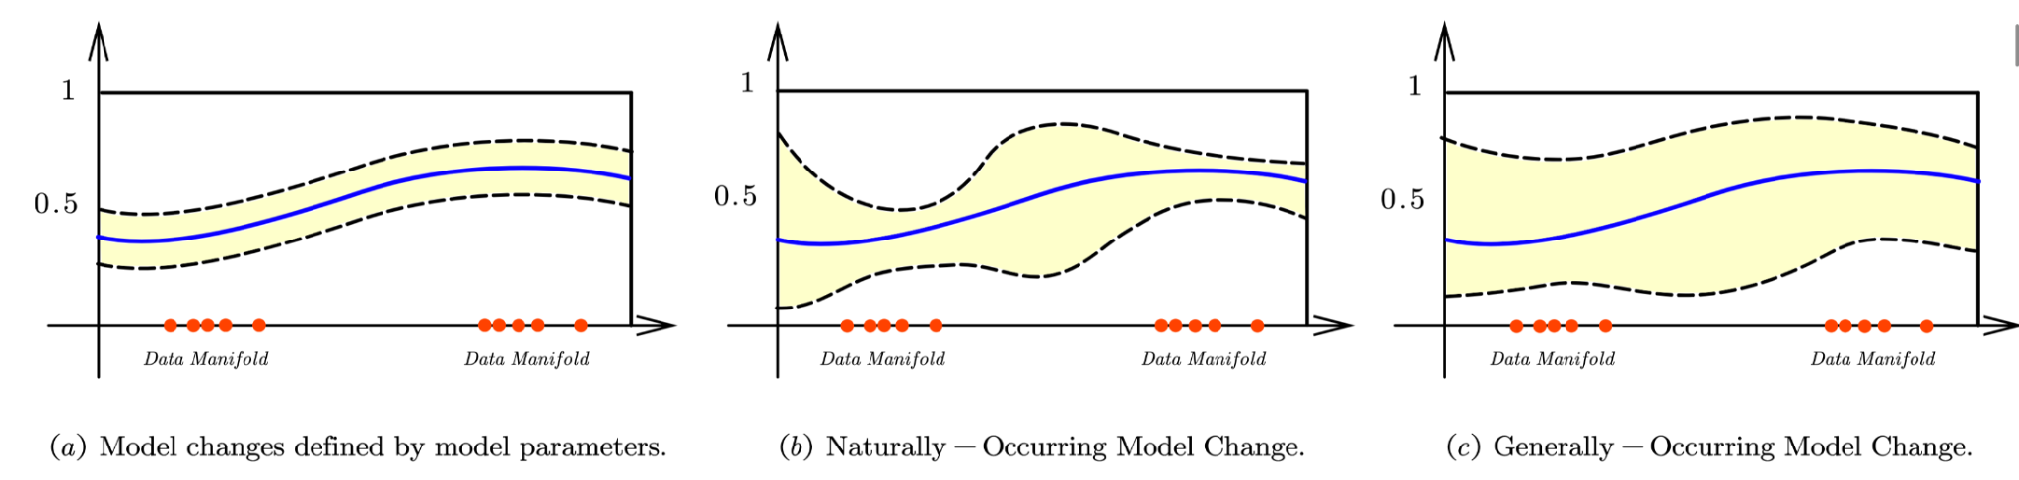
Different perspectives on model changes?
Jiang et al. 2022 [1] define model change as an update to model parameters
Xu and Wu et al. 2024 [2] define model change as the inner product between functions

Slide 5
Our perspective on model change
New models can be a result of a change in
  Data
  Model architecture
  Training algorithm
  Other, application-specific parameters

Slide 6
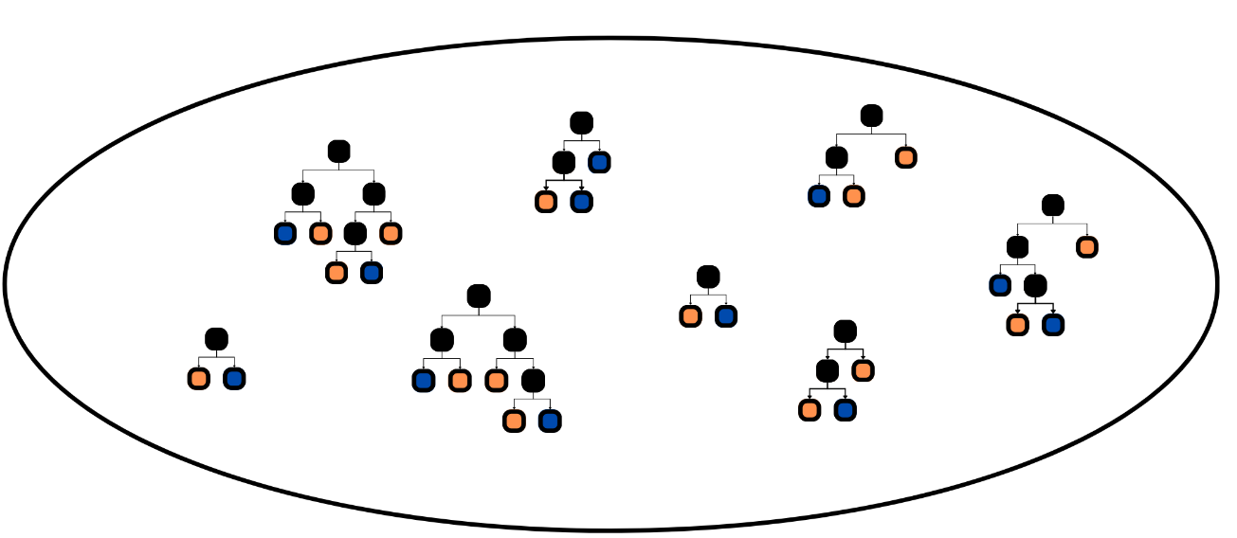
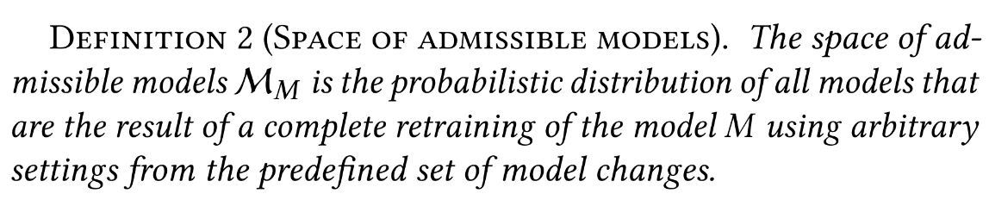
Space of Admissible Models (SAM)
A space that contains models which you expect to might see in the future. For instance, these changes can be as simple as model retraining + architecture modifications, data shift or random seed change. Compatible with any model type.

Slide 7
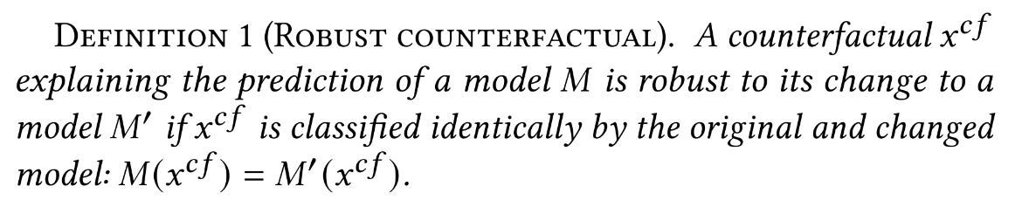

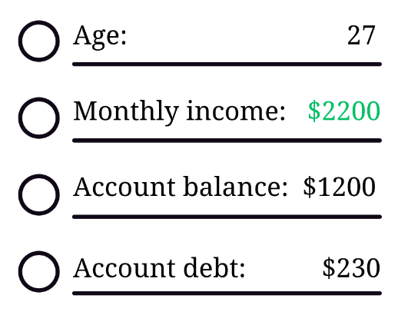
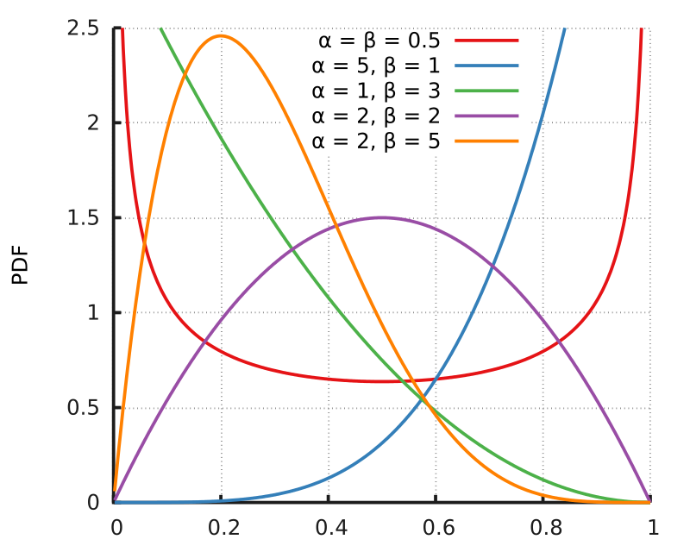


How to verify CF robustness?
A counterfactual is robust if it’s classified identically for both the original model and a new, changed model
SAM
Sample
Verify
CF
https://en.wikipedia.org/wiki/Beta_distribution

Slide 8
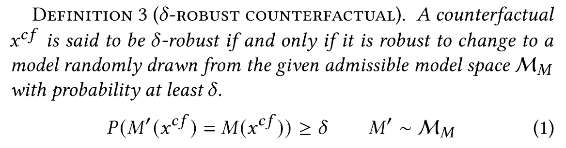

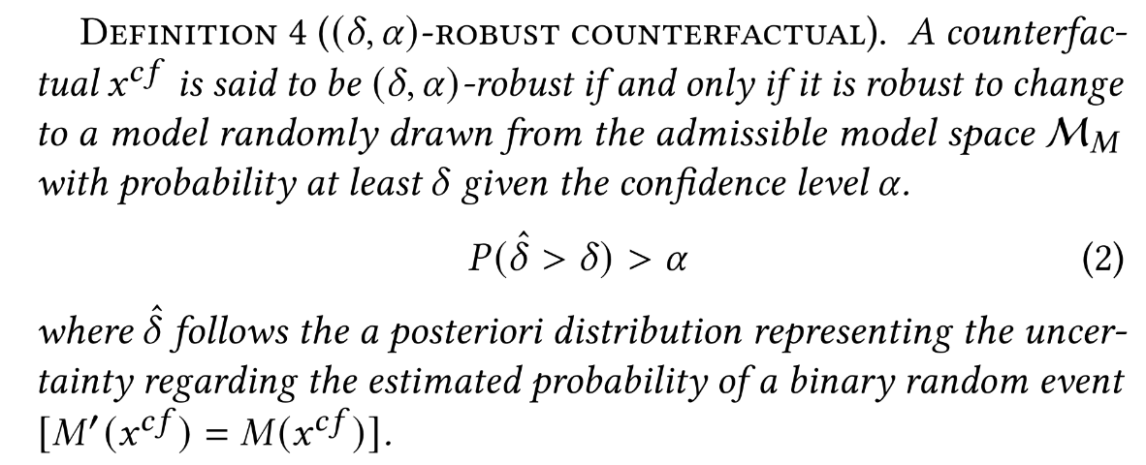

Modeling robustness

Slide 9
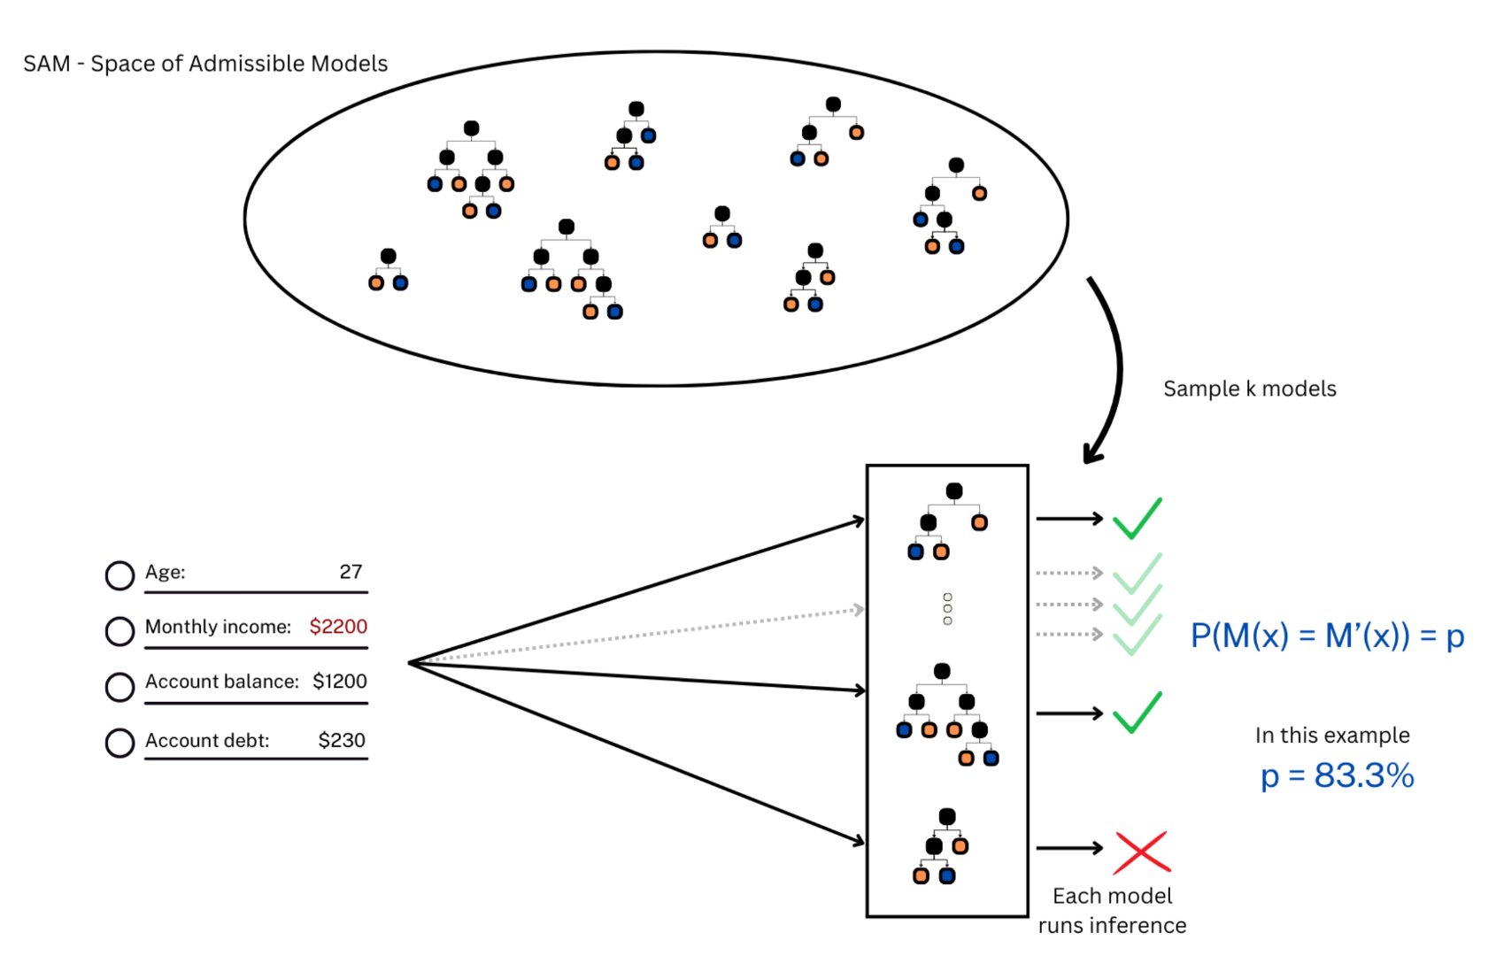
Verification
Sample k models from SAM
Classify CF with these models
For each prediction check if M(x) == M’(x)
Count the number of robust CFs to estimate p
Use this evidence to update the noninformative Jeffreys prior for robustness (Beta)
Finally, verify if the counterfactual is (𝛿, 𝛼)-robust
1
3
4
2

Slide 10
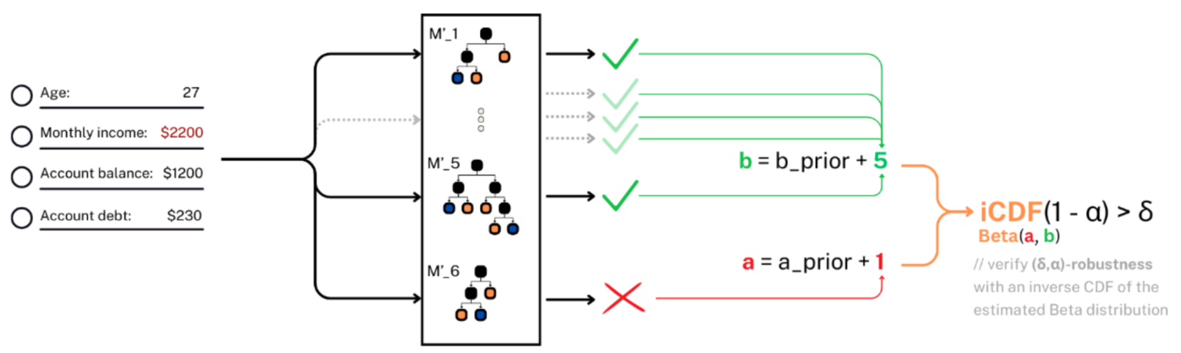
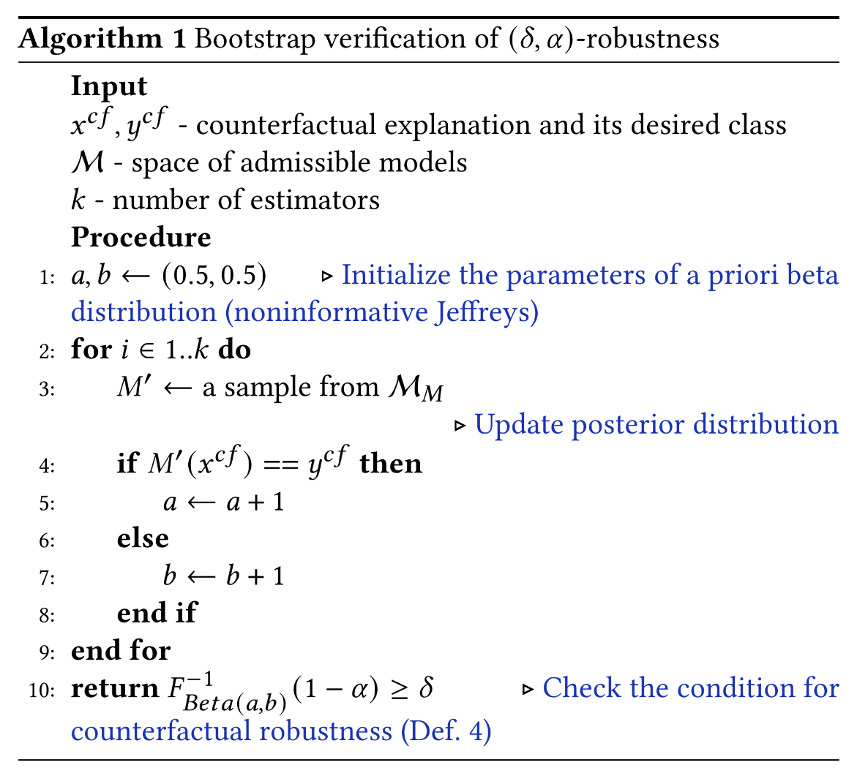
Verification
6
Sample k models from SAM
Classify CF with these models
For each prediction check if M(x) == M’(x)
Count the number of robust CFs to estimate p
Use this evidence to update the noninformative Jeffreys prior for robustness (Beta)
Finally, verify if the counterfactual is (𝛿, 𝛼)-robust
5

Slide 11
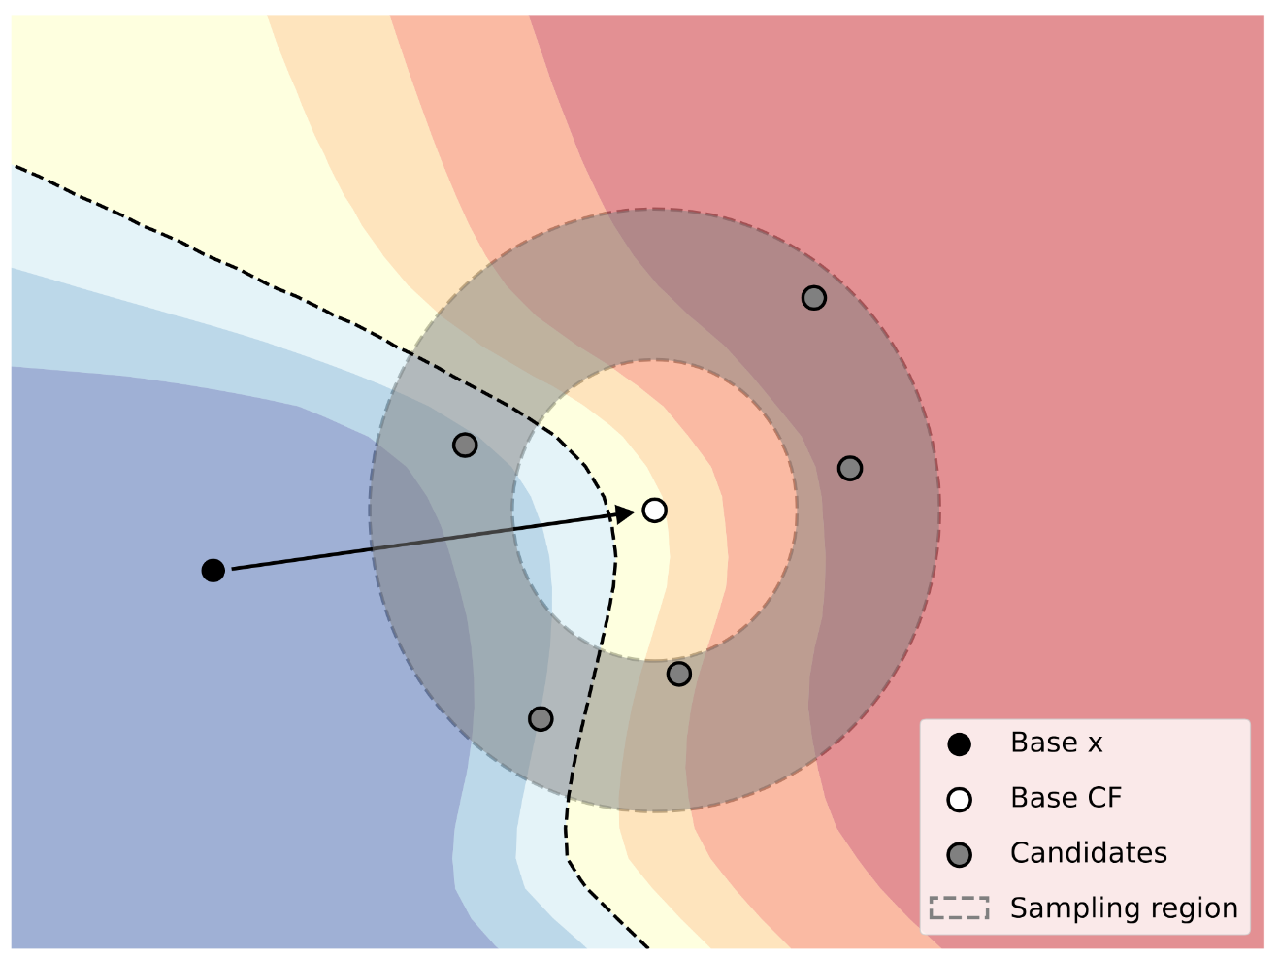

BetaRCE
Post-hoc
  First, a base CF generation method is used e.g., DiCE [3] or Wachter [4]
  Then, BetaRCE robustifies the base CF
Objective function
  Distance to the base counterfactual
  Validity term (correct class)
  Robustness term (maintains the same class under a new model)
Optimization algorithm
  We use GrowingSpheres [5], a zeroth-order optimizer

Slide 12
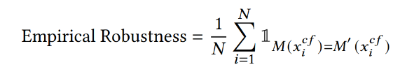
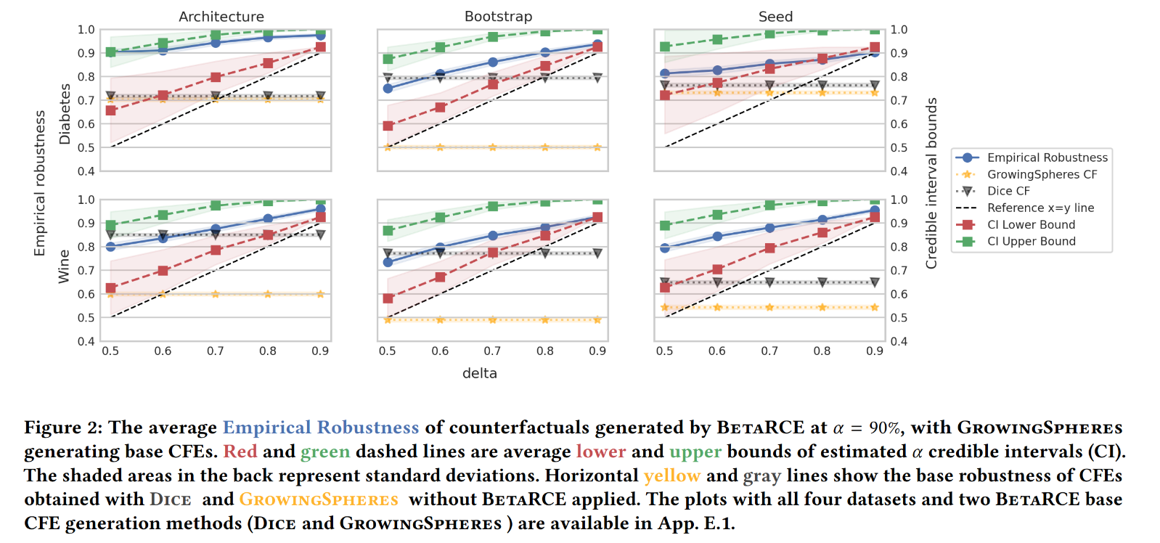
Empirical Evaluation

Slide 13
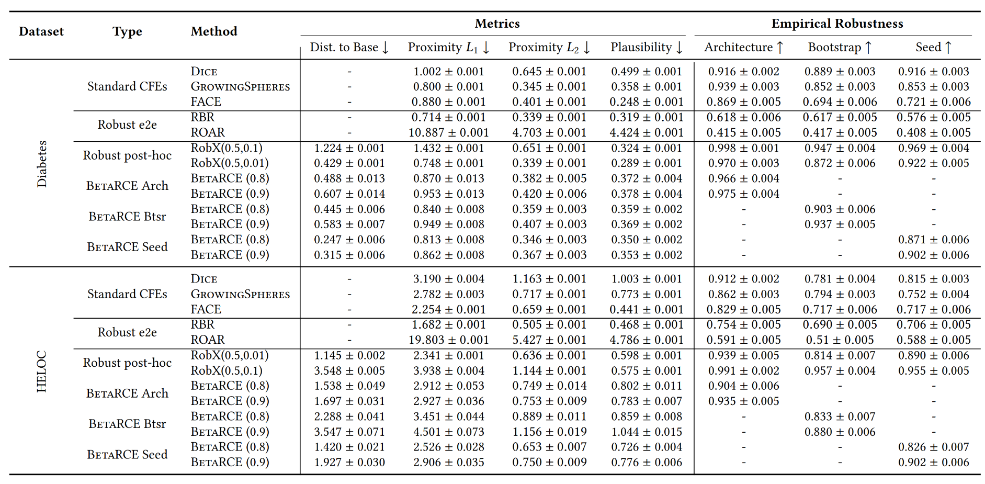
Comparing to other methods

Slide 14
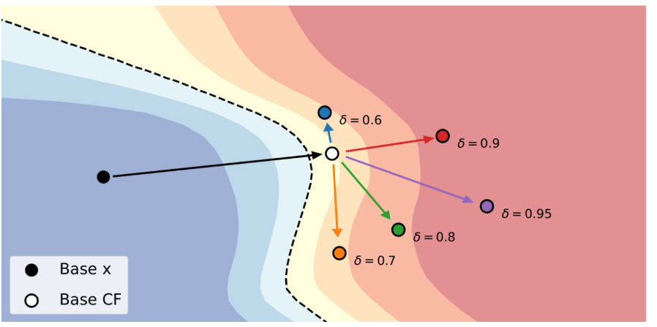
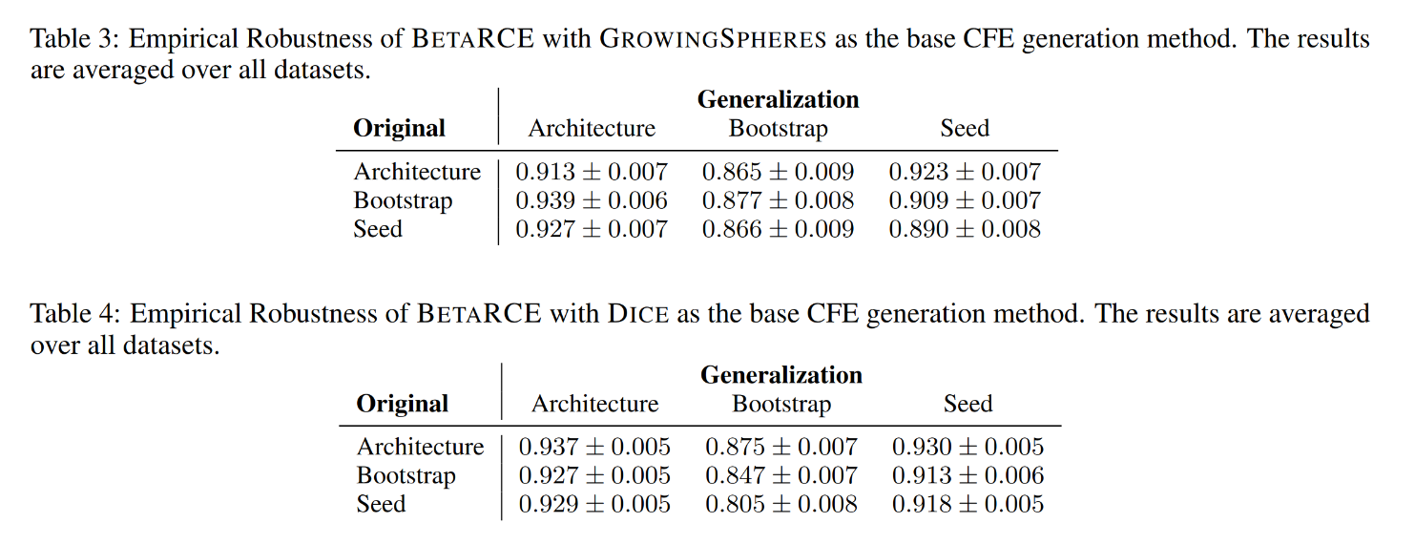
Out-of-distribution model change

Slide 15
Summary
✅ Pros:
Probabilistic guarantees on robustness
Model-agnostic, is post-hoc and compatible with any CFE method
User-tunable interpretable hyperparameters: δ (robustness), α(confidence)
Requires no modifications to your model
❌ Cons:
Computational efficiency
Need to define your Space of Admissible Models

Slide 16
Future Work
Formalization of what a small model change is to better define SAM
Differentiable objective function + first-order optimization
Mixed attribute handling
Other than tabular modalities

Slide 17
References
[1] Junqi Jiang, Francesco Leofante, Antonio Rago, and Francesca Toni. Formalising the robustness of counterfactual explanations for neural networks. In Proceedings of the AAAI Conference on Artificial Intelligence, volume 37, pages 14901–14909, 2023
[2] Ao Xu and Tieru Wu. Generally-occurring model change for robust counterfactual explanations. In Artificial Neural Networks and Machine Learning – ICANN 2024: 33rd International Conference on Artificial Neural Networks, 2024
[3] Ramaravind Kommiya Mothilal, Amit Sharma, and Chenhao Tan. Explaining Machine Learning Classifiers through Diverse Counterfactual Explanations. In Proceedings of the 2020 Conference on Fairness, Accountability, and Transparency, pages 607–617, 2020
[4] Sandra Wachter, Brent Mittelstadt, and Chris Russell. Counterfactual Explanations Without Opening the Black Box: Automated Decisions and the GDPR. SSRN Electronic Journal, 2017
[5] Thibault Laugel, Marie-Jeanne Lesot, Christophe Marsala, Xavier Renard, and Marcin Detyniecki. Comparison-based inverse classification for interpretability in machine learning. In Information Processing and Management of Uncertainty in Knowledge-Based Systems. Theory and Foundations: 17th International Conference, IPMU, 2018

Slide 18

Thank you!
Shoot us an email
ignacy.stepka@cs.put.poznan.pl
jerzy.stefanowski@cs.put.poznan.pl
Connect on LinkedIn
https://linkedin.com/in/ignacy-stepka
Check out the project website for tutorials, code, paper, extra experiments and more!
https://ignacystepka.com/projects/betarce
This research was funded by National Science Centre,
Poland OPUS grant no. 2023/51/B/ST6/00545

Slide 19
EXTRA DECK

Slide 20
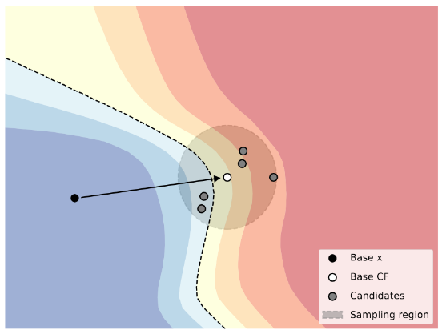
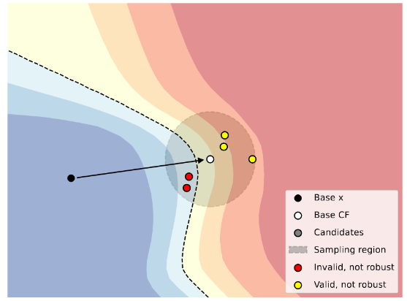

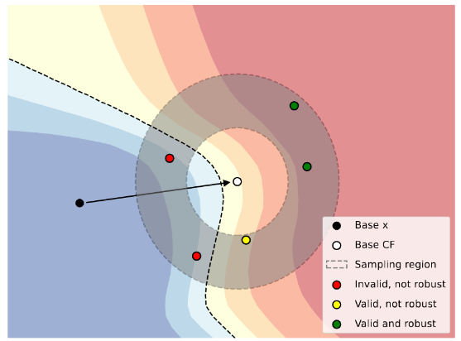
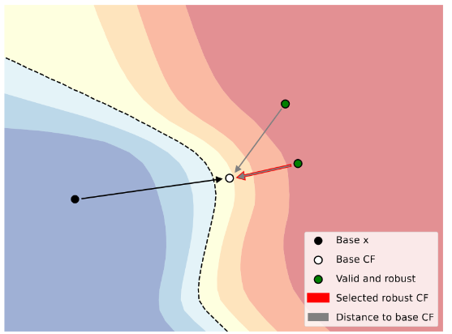
BetaRCE in action

Slide 21
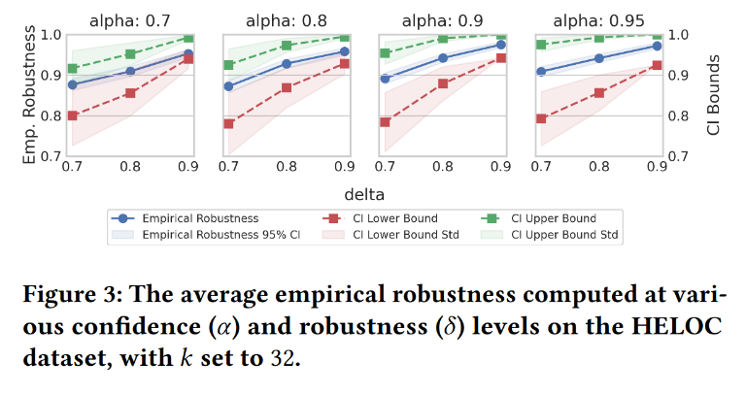
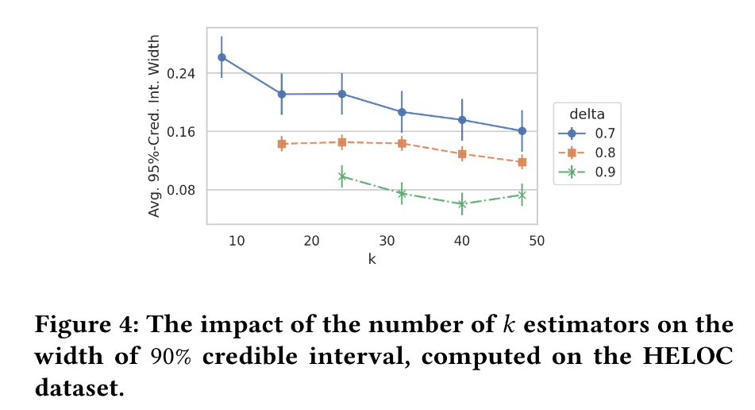
Hyperparameter sensitivity analysis

Slide 22
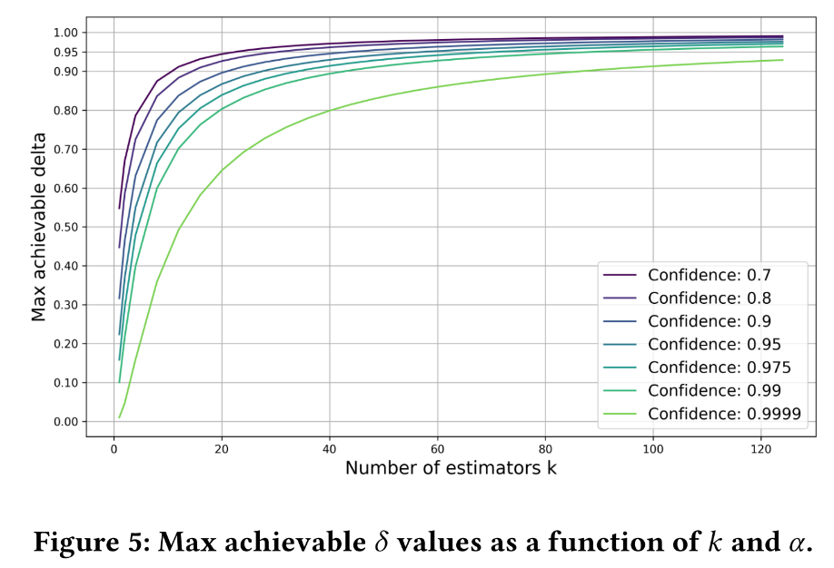


Slide 23
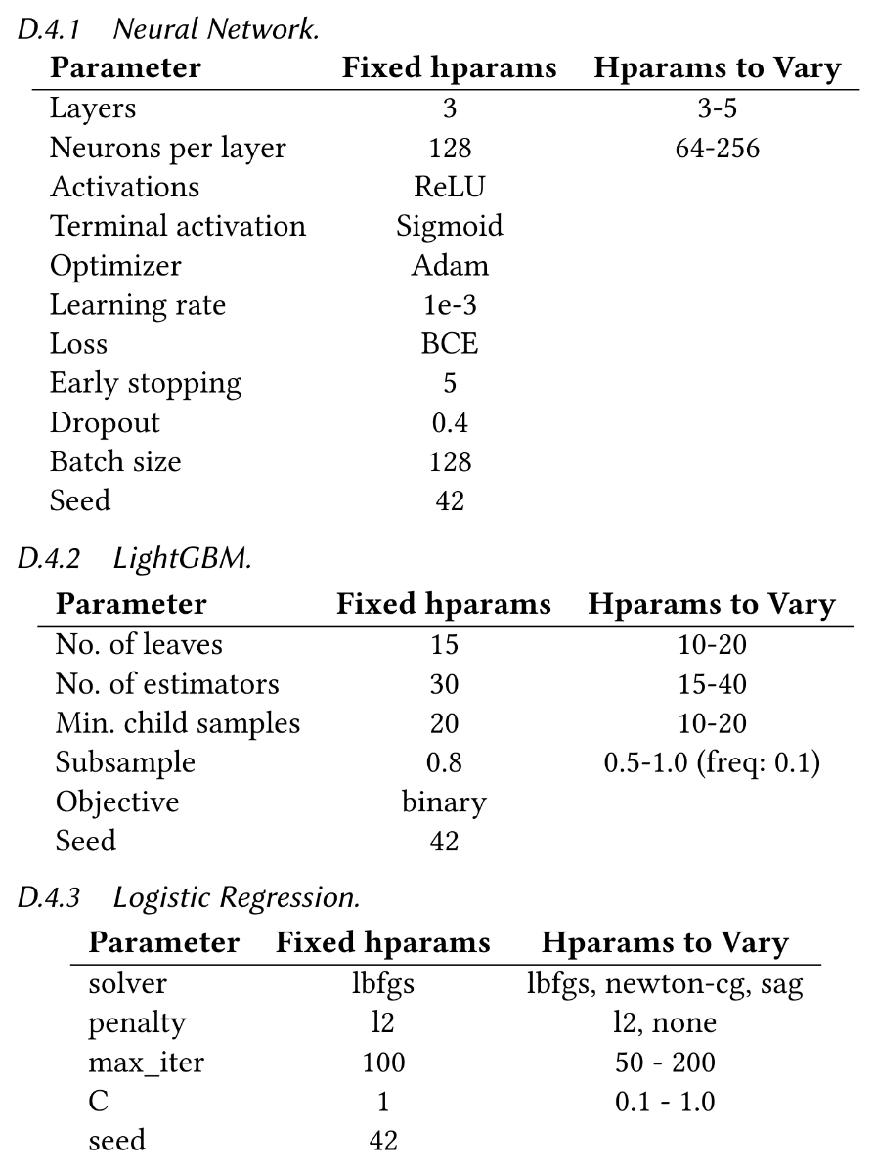

Slide 25
